Slide 1
Atomicity across Layers & Multiple Sites

Slide 2
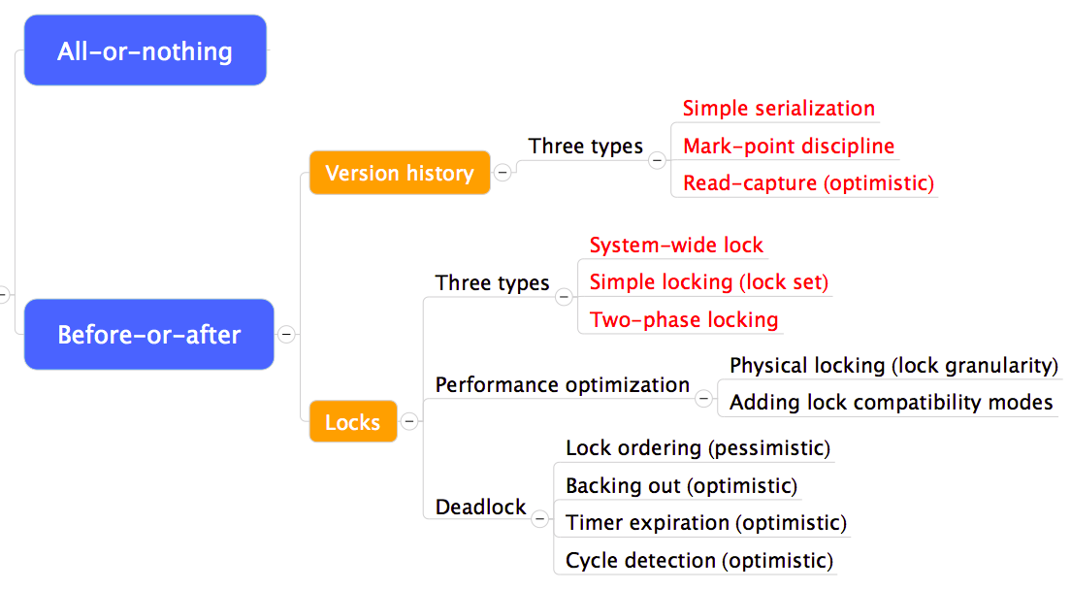
Review so far

Slide 3
Two-phase locking
Two-phase locking (similar as read-capture)
  Avoids to know lock set in advance
  Acquire locks as it proceeds, access data as soon as it acquires the lock
Constraints
  Not release any locks until passes lock point
  Only release a lock if never need to read/write again
Problems
  Widely used, but hard to argue correct

Slide 4
Two-phase locking
Unnecessary blocking
  Example
    T1: READ X
    T2: WRITE Y
    T1: WRITE Y
    T1’s & T2’s lock sets intersect at Y
  Two-phase locking prevents interleaving
    But T1/T2/T1 = T2/T1/T1
    NP-complete

Slide 5
Interactions between locks and logs
Transaction abort
  Restore its changed data before release locks
  Just like transactions doing nothing
System recovery
    Change data,------need lock again ?
  Not log locks ？
    Non-complete transactions have no overlapping lock sets at the moment of crash
    Yes, Locks are only in volatile memory is ok

Slide 6
Performance optimizations
Physical locking VS. logical locking
  Choose lock granularity
    E.g. change 6-byte object of a 1000-byte disk sector,
    or change 1500-byte object on two disk sectors
    Which to lock: the object or sector?
  Logical locking
    If objects are small: more concurrency, more logging
    New logical layer between app and disk
      E.g. data object management and garbage collection
  Physical locking
    Tailor the logging and locking design to match disk granularity
      Disk sectors rather than object is a common practice

Slide 7
Performance optimizations
Lock compatibility modes
  Multiple-reader, single-writer protocol
    Any number of readers is safe
    Only one writer, wait for all reader to finish
    Suitable for applications with a lot of reading
    A writer may be delayed indefinitely
  More specific, more complex

Slide 8
Deadlock & making progress
Inevitable if using locks in concurrency
  1. Waiting for one another
  2. Waiting for a lock by some deadlocked one
  Correctness arguments ensures correctness, but no progress
Methods
  Pessimistic ones: take a priori action to prevent
  Optimistic ones: detect deadlocks then fix up

Slide 9
Methods for solving deadlock
Lock ordering (pessimistic)
  Number the locks uniquely
  Require transactions acquire locks in ascending order
  Problem: some app may not predict all of the locks they need before acquiring the first one
Backing out (optimistic)
  Allow acquire locks in any order
  If it encounters an already-acquired lock with an number lower than one it has previously acquired itself, then
    UNDO: Back up to release its higher-numbered locks
    Wait for the lower-numbered lock and REDO

Slide 10
Methods for solving deadlock
Timer expiration (optimistic)
  Set a timer at begin_transaction, abort if timeout
  If still no progress, another one may abort
  Problem: how to chose the interval?
Cycle detection (optimistic)
  Maintain a wait-for-graph in the lock manager
    Shows owner and waiting ones
    Check when transaction tries to acquire a lock
  Prevent cycle (deadlock)
    Select some cycle member to be a victim

Slide 11
Deadlock & making progress
Live-lock still possible
  Two transactions with the same timeout value
Exponential random backoff
  Delays the thread for a random time
  Repeated retries failing indicate deeper problem
End-to-end argument
  Worth the effect?

Slide 12
Two problems: multi-layer & multi-site
How to commit in multi-layer transaction?
  UNDO: require the results of low-layer transaction be visible only within the higher-layer one
  Delay: delay low-layer commitment to when high-layer commitment commits
How to provide atomicity in multi-site?
  Communication delay & reliability, independent failure
Solution
  Nested transaction => two-phase commit
  Specialized form of RPC to coordinate steps

Slide 13
Hierarchical composition of transactions
Three layers all need atomicity
  TRANSFER, PAY_INTEREST, MONTH_END_INTEREST
    What if transferring money from A to B between two PAY_INTEREST in one MONTH_END_INTEREST?
MONTH_END_INTEREST
PAY_INTEREST
TRANSFER

Slide 14
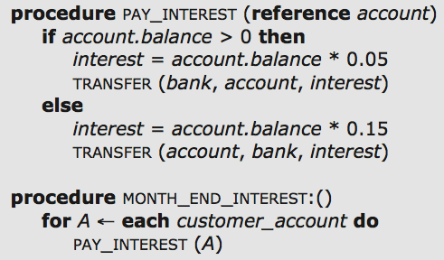
Hierarchical composition of transactions

Slide 15
How to commit?
PAY_INTEREST
  TRANSFER commits before PAY_INTEREST commits
    If crash, PAY_INTEREST cannot go back
  TRANSFER commits after PAY_INTEREST commits
    If crash, TRANSFER may have not done and no redo
MONTH_END_INTEREST
  No other TRANSFER should occur
  Do multiple TRANSFER itself
    Which are before-or-after actions

Slide 16
Hierarchical record
Superior record & dependent record
  Top-layer uses a flag to indicate no nest
  Sub-layer contains higher-layer TID
When create a nested transaction
  Record both initial state of the new transaction and the ID of the enclosing transaction
When check commit
  The outcome of a transaction depends on its ancestors
  Tentatively commit: sitting on a knife-edge

Slide 17
Hierarchical record
Delayed output visibility
  A nested transaction waits for highest layer to commit
    E.g. open cash drawer
Maintain tentatively committed state indefinitely
  Maybe commit or abort
  What about holding a lock?
Interaction among transactions
  May cause build-in cycle of waits

Slide 18
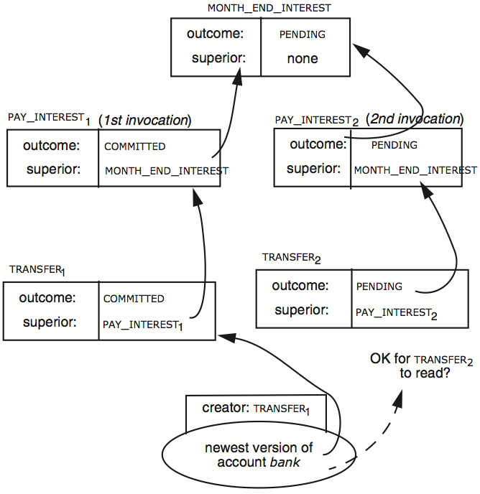

Slide 19
Two-phase commit
Phase-1: preparation / voting
  Lower-layer transactions either aborts or tentatively committed
  Higher-layer transaction evaluate lower situation
Phase-2: commitment
  If top-layer, then COMMIT or ABORT
  If nested itself, then become tentatively committed

Slide 20
Multiple-site atomicity: distributed two-phase commit
Multiple-site atomicity
  A transaction requires several transactions at different sites in a best-effort network
  Message may be lost, delayed or duplicated
  Use RPC to communicate
    Ensure at-least-once by persistent sender
    Ensure at-most-once by duplicate suppression
    However, neither is enough to ensure atomicity here
  Combine three components
    At-lease-once, at-most-once, one-site transaction

Slide 21
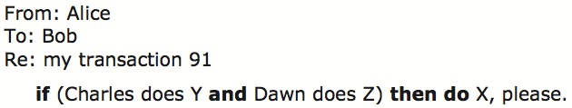
Multiple-site atomicity
Worker: Bob, Charles, Dawn
  Does three transactions: X, Y, Z
Coordinator: Alice
  Create a higher-layer transaction
  Send three messages to the three workers
Challenge: un-reliable communication

Slide 22
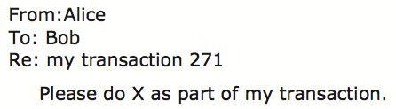
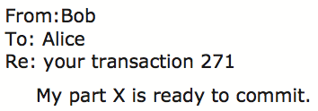
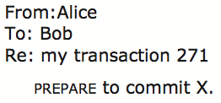

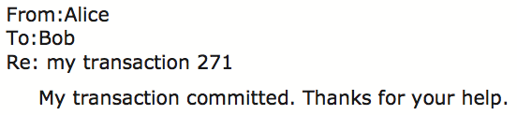
Commit Phase-1
Bob: tentative committed
State: PREPARED
Commit Phase-2
Bob: COMMITTED
Bob will perform post-commit

Slide 23
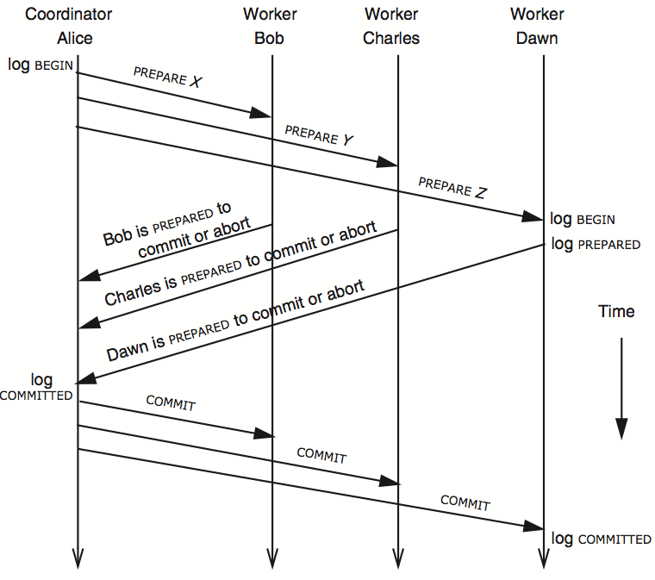
3N messages

Slide 24
Multiple-site atomicity
Coordinator
  Collect some ABORT or nothing: ABORT or assign the work to another worker
  Collect all COMMIT: then COMMIT
Worker
  When receive nothing: resend PREPARED
    Coordinator will send current state if it receives duplicate message
  When receive COMMIT: then COMMIT

Slide 25
Worker crash recovery
If a worker uses logs and locks crashes
  1. Classify any PREPARED transaction as a tentative winner that it should restore to the PREPARED state
  2. If worker uses lock, recovery reacquires any locks the PREPARED transaction was holding when fail
  3. Restart the persistent sender to learn the current status of higher-layer transaction
If a worker uses version history
  Only step-3 is needed

Slide 26
Variation of 3N protocol
Carry PREPARE/PREPARED in initial RPC req/rep
  Lose the ability to ABORT when PREPARED
  Must remain on the knife edge
  It is preferred to delay the PREPARE/PREPARED pair
4N: with ACKs
  Coordinator safely discard its outcome record after collecting all ACKs
Presumed commit
  Expect most transactions commit
  Space-efficient representation of COMMITTED: non-existence
    COMMIT by destroy the outcome record, but not when ABORT
  Answers inquiry about a non-existent outcome record by sending a COMMITTED response

Slide 27
Unsolved problem
What if the coordinator crash after sending PREPARE but before sending COMMIT?
  Workers are left in PREPARED with no way to proceed
A problem that cannot be solved
  Several workers will do their parts eventually, not necessarily simultaneously
  Alice would in trouble if she had required simultaneous action

Slide 28
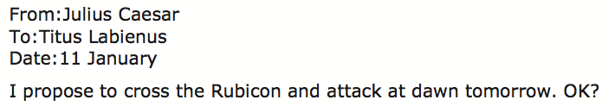
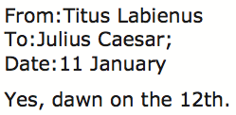

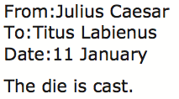
The dilemma of the two generals

Slide 29
The conclusion of two generals
There is no protocol with a bounded number of messages that can convince both generals that it is safe to march
  If there is, then the last message must be unnecessary, then could be deleted
Practical method
  Consider the probability of accomplished within a specified time
  Then send several runners

Slide 30
Case studies: machine language atomicity
Complex instruction sets: the general electric 600 line
  Indirect and tally: set by one-bit of indirect address
  Load register A from Y indirect.
    First Y++, then A = [Y.old]
    Can be used to sweep through a table
  Problem: page fault?
    The indirect word and operand are in different pages
    Then the state of the processor is “half-way of a instruction”
  Solution: save internal state: 216-bit
    Programmer get info not in the API
    Be careful when restore

Slide 31
More elaborate instruction sets: the IBM system/370
Multi-operand character-editing instruction
  TRANSLATE contains 3 arguments
    Two address: string and table
    8-bit counter: length
    Takes 1 byte at a time from string, as an offset in table, get the byte in table, then replace the byte in string
  Problem: page fault
  Solution: dry run
    Hidden copy of register make no change to memory
    Maybe several dry run for one instruction
    Then run it again
  Problem: what if another process snatch a page?

Slide 32
The Apollo desktop computer and Motorola M68k
Problem: ISA is not atomic when adding VM, and multiple processors
Solution: install two 68k
  When the first encounters a page fault, stops
  The second fetches the missing page, restarts the first one
Solution-2:
  Modify compilers to generate atomic instruction only
  More tricky but risky
Solution-3:
  Save internal state

Slide 33
Review problem set 37: two-phase commit
First phase: PREPARE / vote
  First, the coordinator sends a PREPARE message to each of the workers.
  For each worker, if it is able to commit, it writes a log record indicating it is entering the PREPARED state and send a YES vote to the coordinator; otherwise it votes NO.
Second phase-1: COMMIT or ABORT
  If all YES, coordinator logs a COMMIT and sends a COMMIT to all workers, which in turn log a COMMIT record. ABORT is similar.
Second phase-2: ACKNOWLEDGMENT / END
  After they receive the transaction outcome, workers send an ACKNOWLEDGMENT message to the coordinator.
  Once the coordinator has received all ACK, it logs an END record.
Crash recovery
  Workers that have not learned the outcome of a transaction periodically contact the coordinator asking for the outcome.
  If the coordinator does not receive an ACKNOWLEDGMENT from some worker, after a timer expiration it resends the outcome to that worker, persistently if necessary

Slide 34
